Slide 1
Code Review Automation Assistant
Group: 7
Group Members:
Ruthvik Tarang Goggi & Nikhil Arethiya

Slide 2
Project Description
The Code Review Automation Assistant is an intelligent software system designed to streamline and enhance the code review process for development teams using GitHub repositories. This system automatically analyzes pull requests submitted by developers, applying customizable quality rules and coding standards to identify potential issues, security vulnerabilities, code smells, and style violations. When a developer submits a pull request, the system receives webhook notifications from GitHub, performs comprehensive static code analysis, and generates detailed review comments directly on the pull request with severity levels and improvement suggestions. Repository administrators can configure review rules, connect multiple repositories, and monitor overall code quality through an interactive dashboard displaying metrics, trends, and quality scores. The system generates comprehensive reports containing detailed findings, code complexity analysis, and actionable recommendations, enabling teams to maintain high code quality standards, reduce manual review time, and ensure consistent adherence to project guidelines.

Slide 3
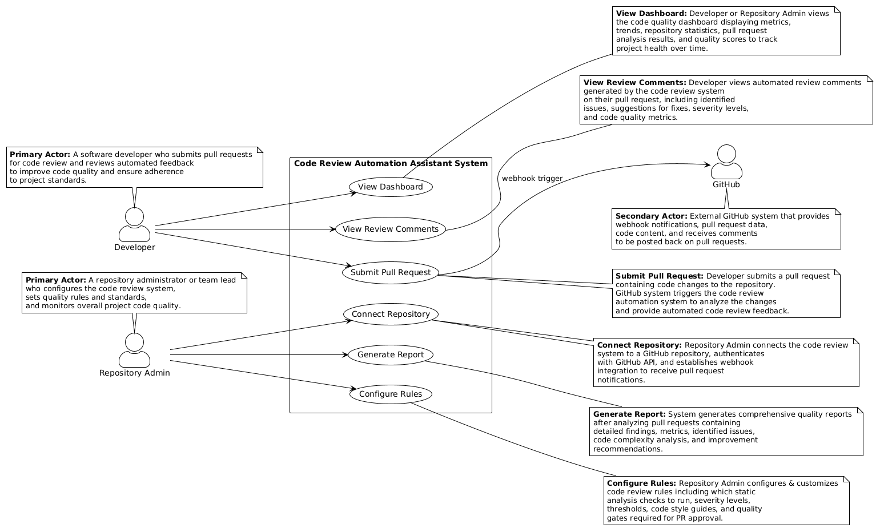
USE-CASE DIagram

Slide 4
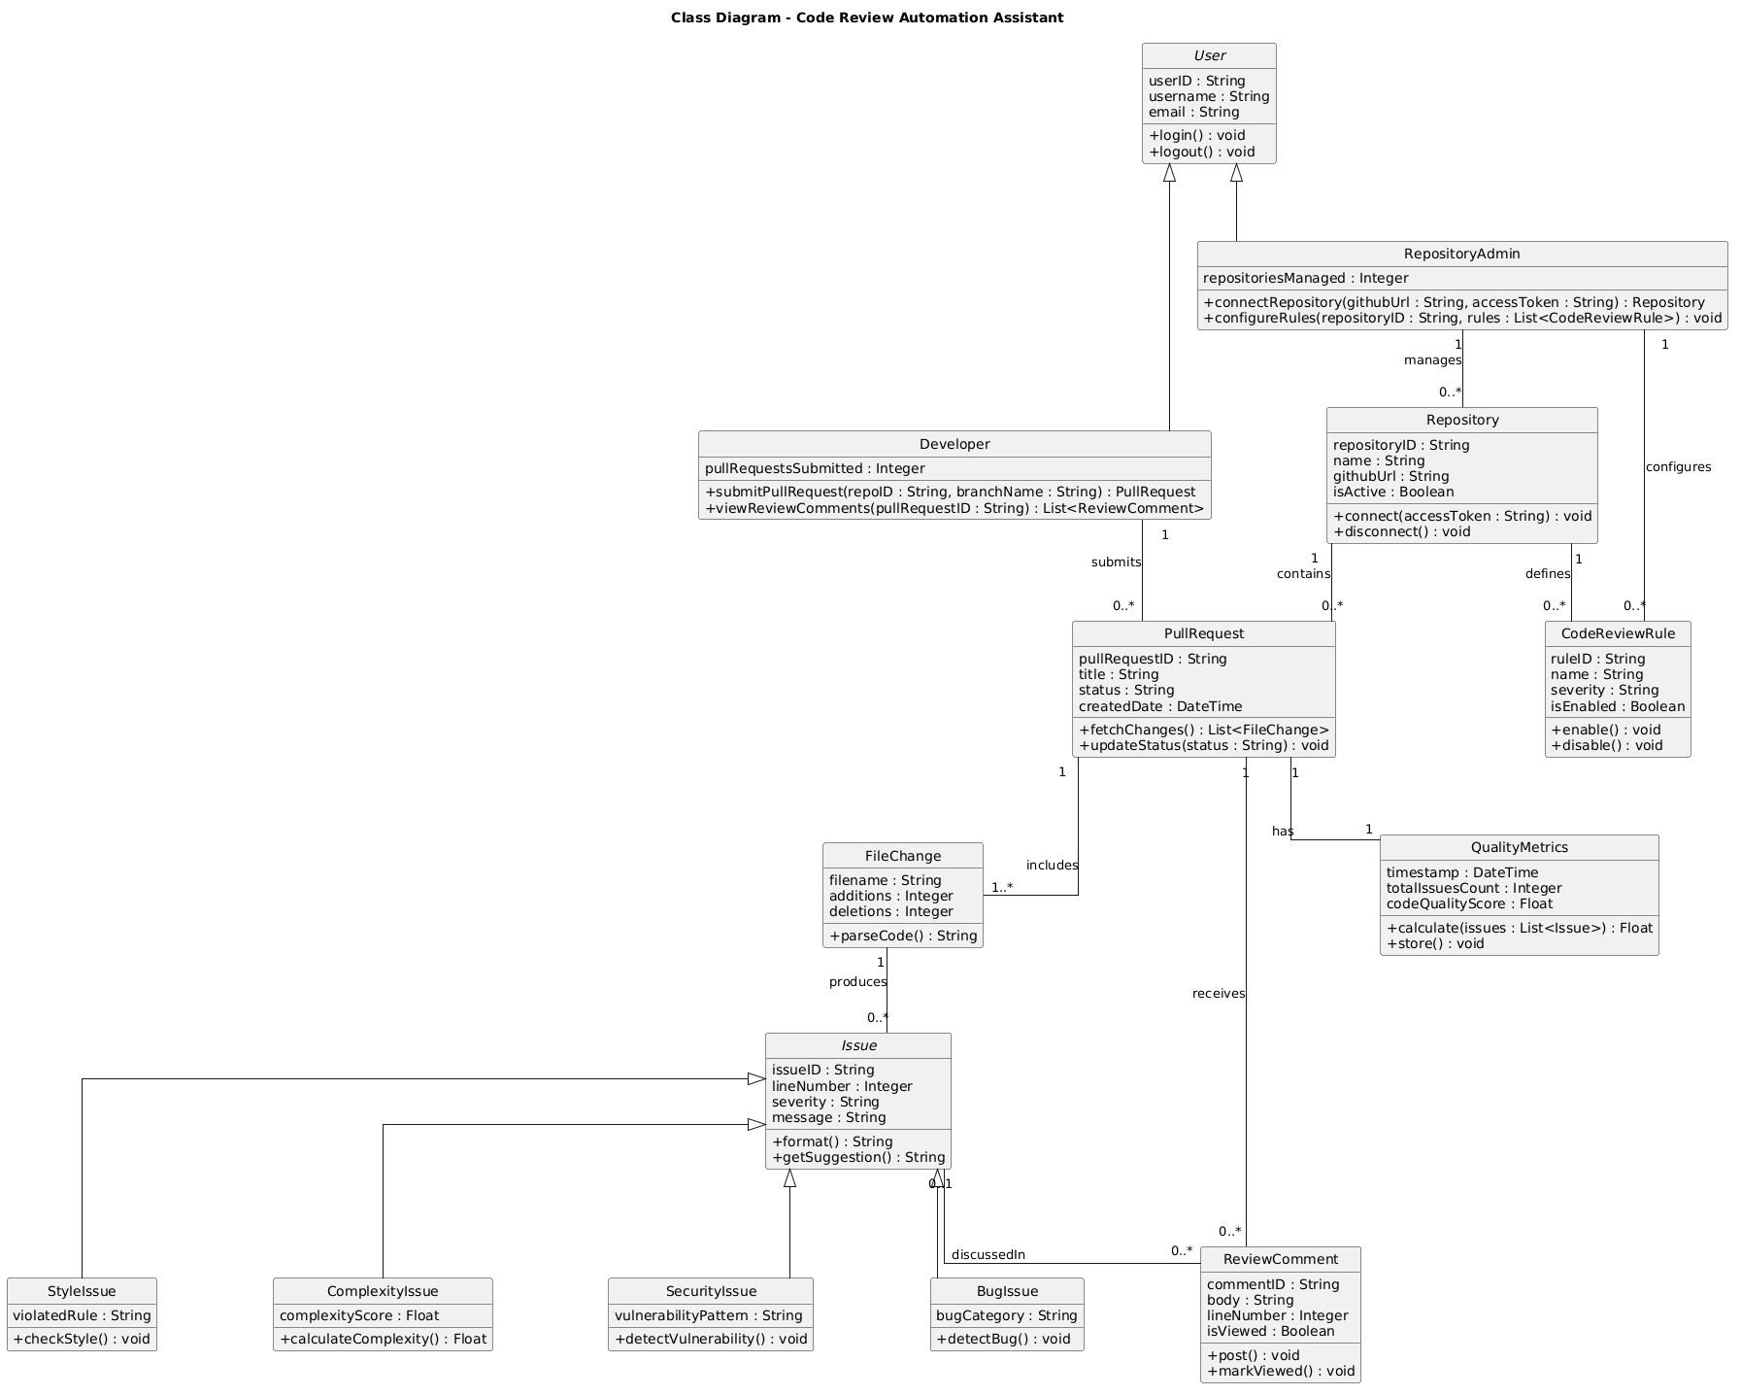
Class Diagram

Slide 5
Sequence Diagram

Slide 6
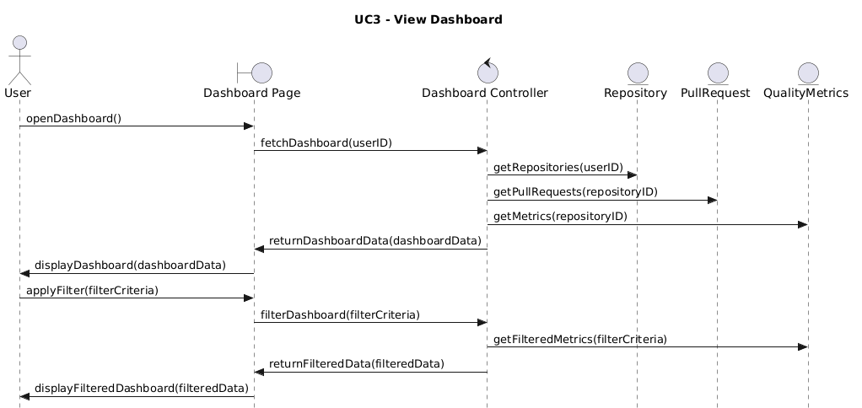
View dashboard

Slide 7
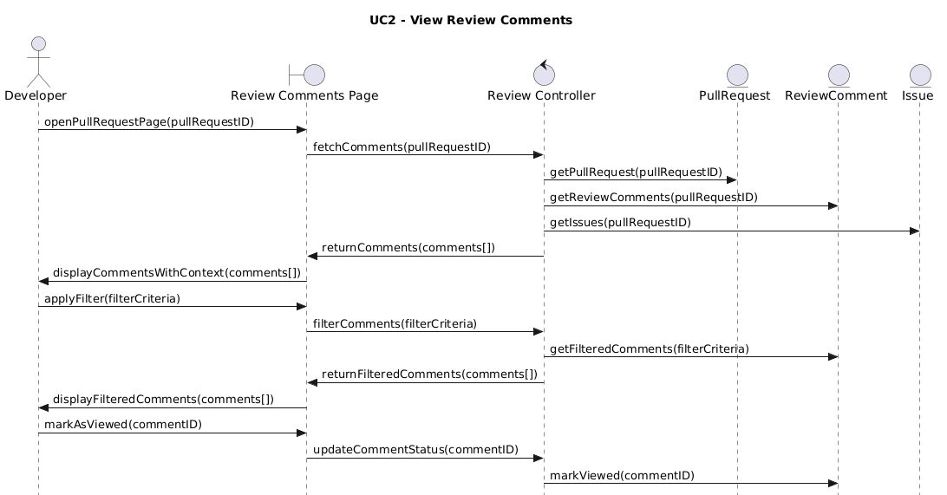
View Review comments

Slide 8
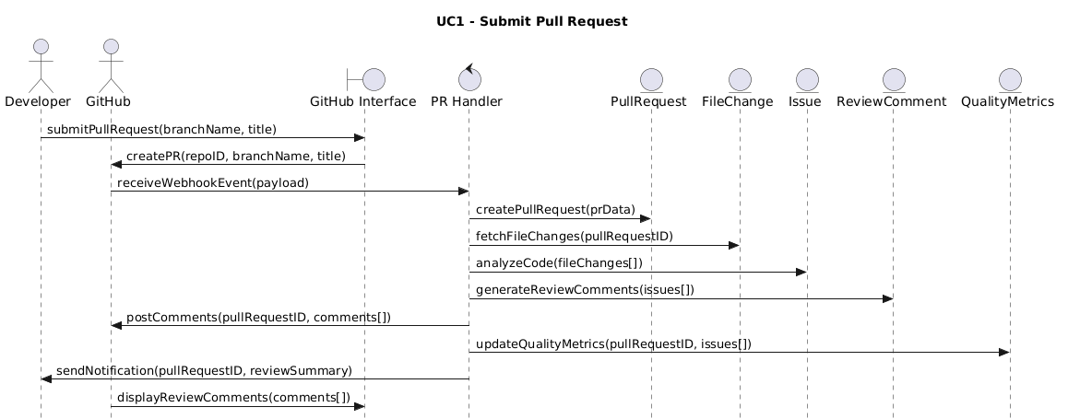
Submit pull request

Slide 9
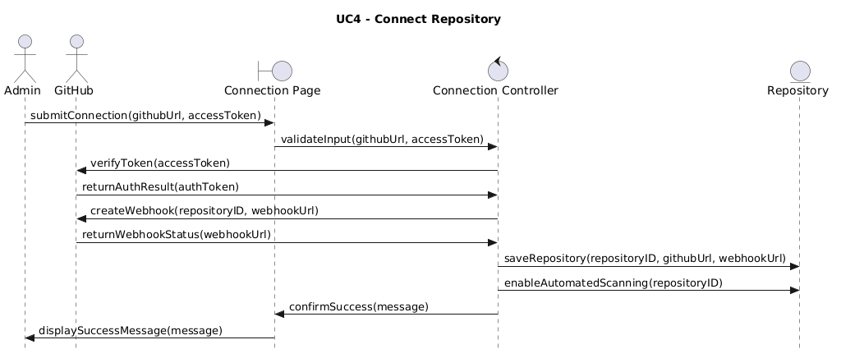
Connect repository

Slide 10
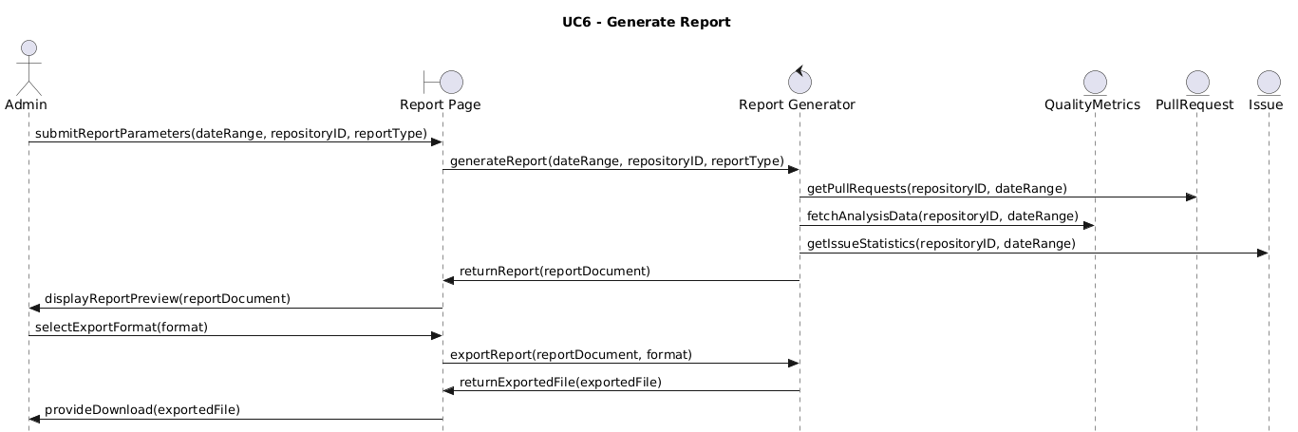
Generate report

Slide 11
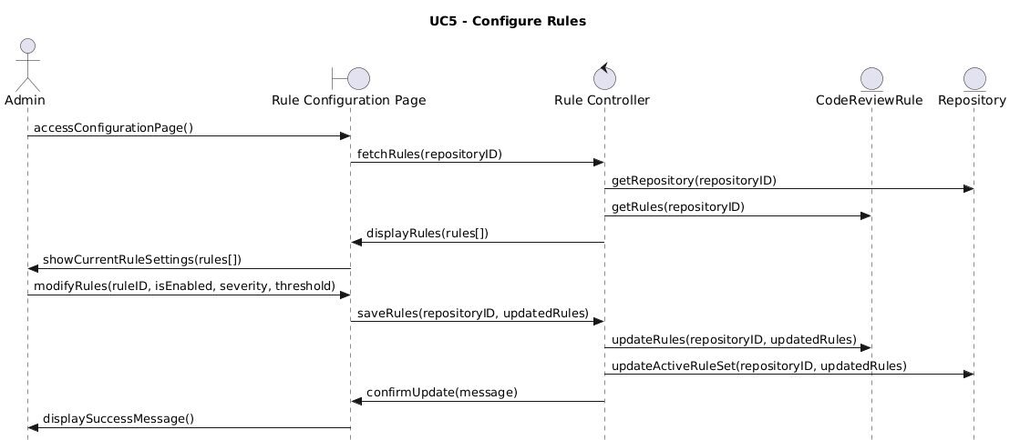
Configure rules

Slide 12
Robustness Diagram

Slide 13
View dashboard

Slide 14
View Review comments

Slide 15
Submit pull request

Slide 16
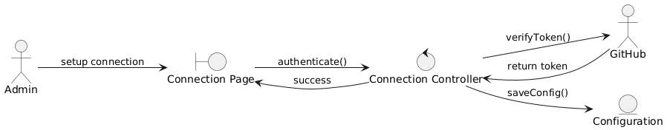
Connect repository

Slide 17
Generate report

Slide 18
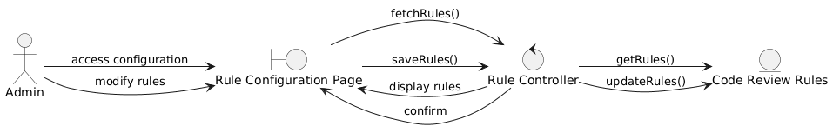
Configure rules

Slide 19
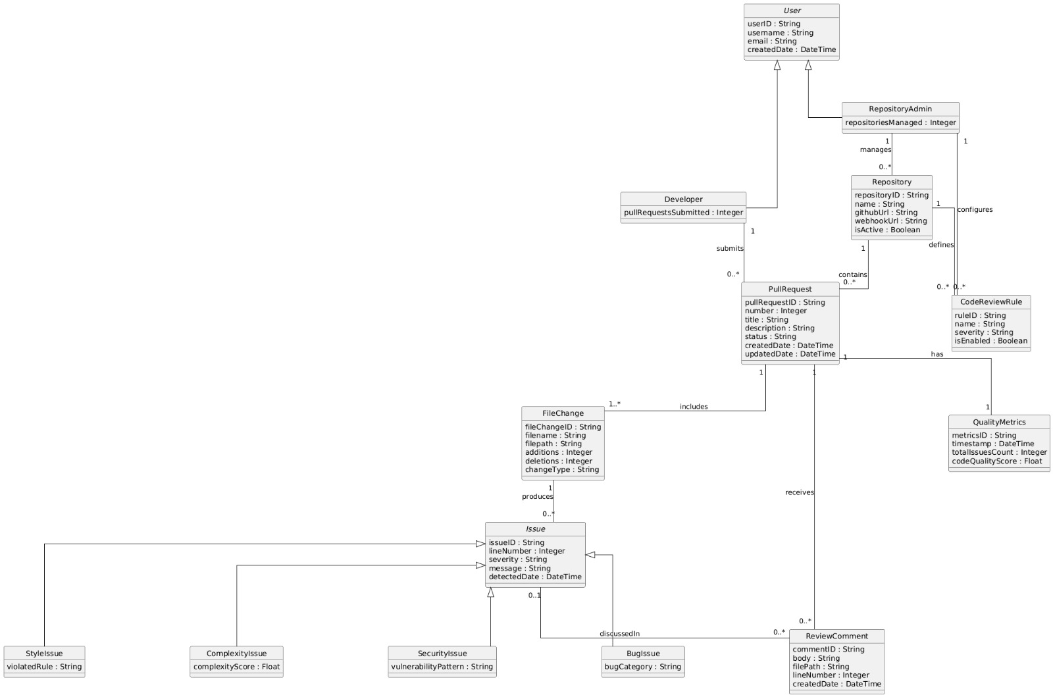
Domain Model Diagram

Slide 20
Activity Diagram

Slide 21
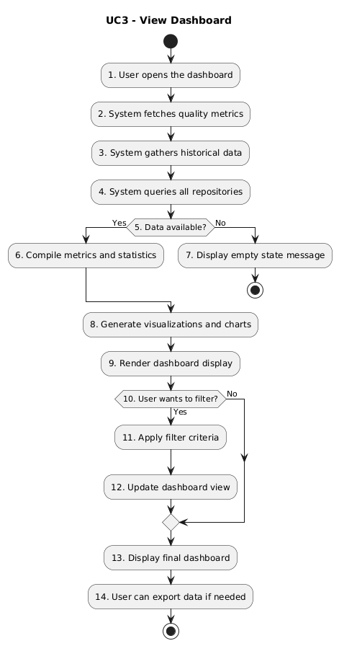
View dashboard

Slide 22
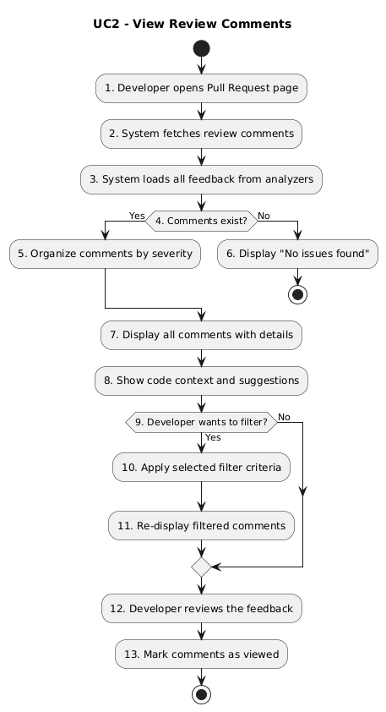
View Review comments

Slide 23
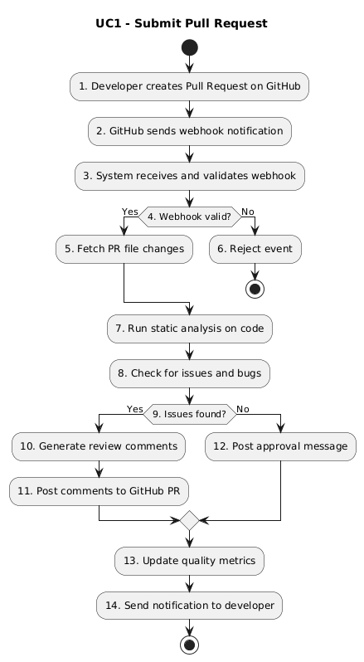
Submit pull request

Slide 24
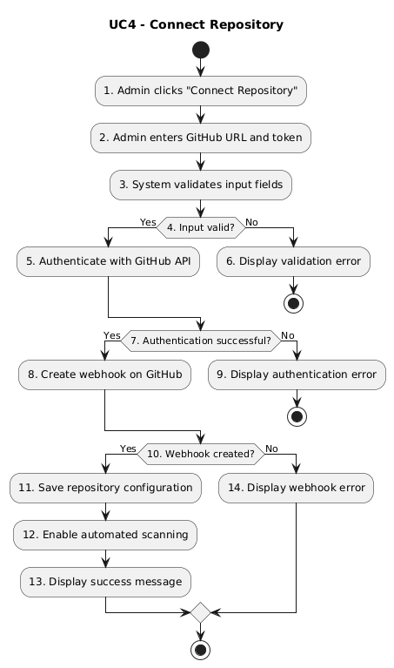
Connect repository

Slide 25
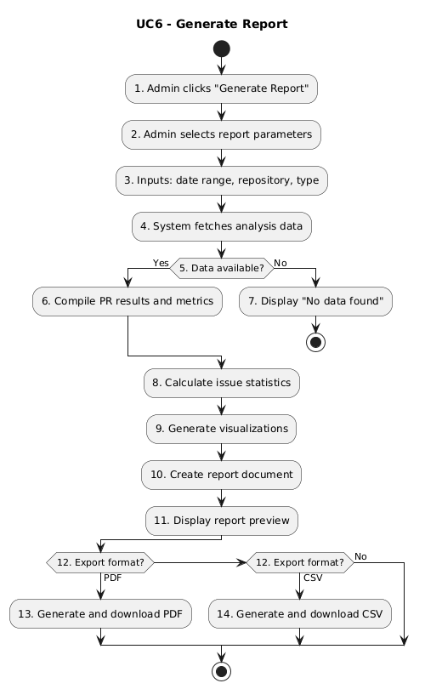
Generate report

Slide 26
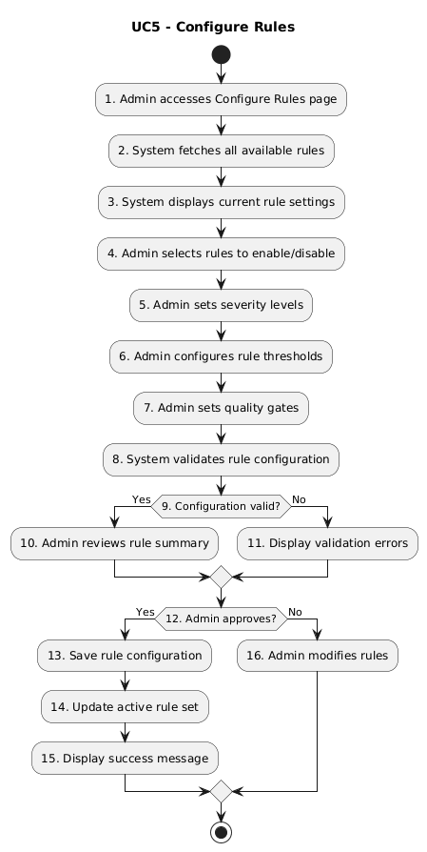
Configure rules

